Slide 1


Slide 2
Correlation of Obesity and Food Options by City Population
Team Members: Liliana Ilut, Vasil Nenov, Quentin Sloboda

Slide 3
Exploring if there is a correlation between the number of restaurants, obesity rate, and household median income in the top 300 counties by population.
Can the number of restaurants in a county be a predictor of that county’s economic standing?
By analyzing the number of restaurants in a given county, we wanted to determine if there was a connection to the median income.
Does a county with a higher economic standing have a lower obesity rate?
Do families that have a higher household income tend to be less obese?
Is there a correlation between the number of restaurants and obesity percentage?
Does the number of restaurants in a county increase the obesity rate of that county?
Is there a correlation between population and number of restaurants?
We wanted to see if the population of a county results in an increase of the number of restaurants in that county.

Slide 4
•We believe we answered the questions to our own satisfaction, however our findings show little to no correlation between our 4 datasets.
•We looked at the obesity rate by county, the number of restaurants in each county, and the median income for each county, then compared those datasets to the 300 most populated counties.
•If we had more specific datasets, we believe that we would have potentially found more correlations.

Slide 5
Exploration:
•We planned on doing population by city but all the other datasets were in counties.
•Most up to date data was from 2016.
Obtaining Datasets:
•Census.gov gave us the full datasets for all 4 of the needed topics.
•NAICS.com gave us the restaurant code number.
Cleaning:
•Once the datasets were obtained the biggest issue was formatting all the numbers to be the same across all.
•Merging is where all the issues came from.
We had to combine the county and state columns into one column.
When merging all 4 we had to remove all the spaces in the “Location” column.

Slide 6
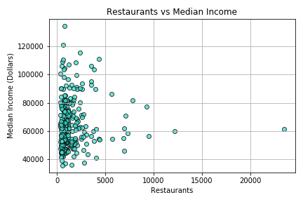
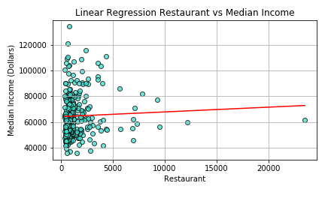
Can the number of restaurants in a county be a predictor of that county’s economic standing?

Slide 7
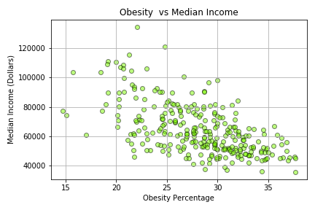
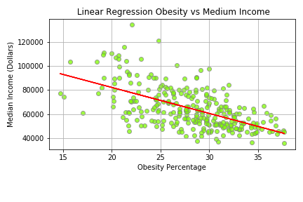
Does a county with a higher economic standing have a lower obesity rate?

Slide 8
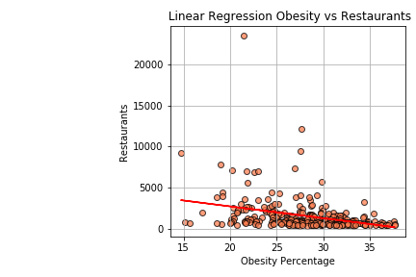
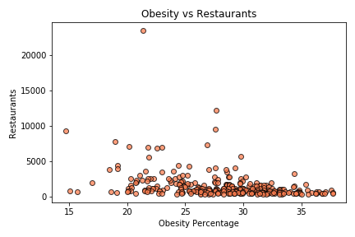

Is there a correlation between the number of restaurants and obesity percentage?

Slide 9
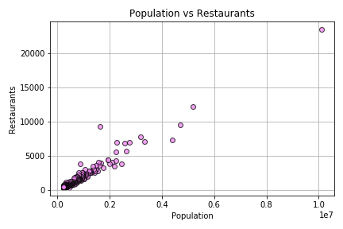
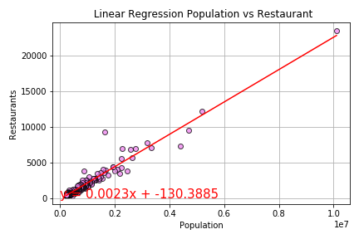

Is there a correlation between population and number of restaurants?

Slide 10

Post Mortem
Discuss any difficulties that arose, and how you dealt with them
Discuss any additional questions that came up, but which you didn't have time to answer: What would you research next, if you had two more weeks?

Slide 11

Questions?

